Slide 1

How to FTP

Slide 2

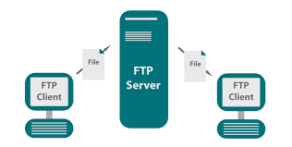
What is FTP?
File Transfer Protocol
It allows you to move files between computers. Basically, a stripped down google drive

Slide 3

Example server
Try accessing ftp.mozilla.org in your browser
If you wanted to, you could get firefox here!

Slide 4
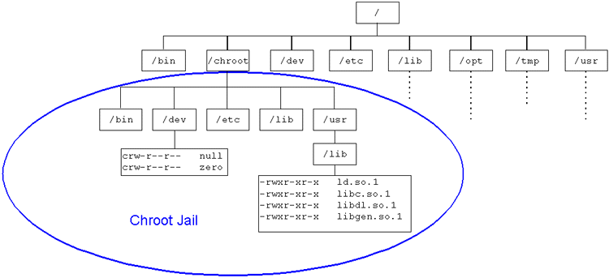
Let’s take a closer look at ftp.mozilla.org
It says “Index of /”
Why would they give us access to /? Doesn’t that compromise their system?
This is known as a chroot jail
What does chroot mean?
Why do we need it?
Notes:
Chroot stands for change root
Basically, it allows you to make a folder appear to be the root directory
And you are confined within that folder, because there’s nothing outside the “root” directory
You need it so that when people access your FTP server, you can allow them to access the appropriate files ONLY

Slide 5
1.
Different types of FTP servers
Wait what there’s more than 1?

Slide 6
Different FTP servers
FTP is not secure
Just look up when it was created
What’s wrong with it?
Different servers arose in order to provide the FTP service with higher levels of security
Ex: Vsftpd and Pureftpd
Notes:
It was designed in 1971 and the problem is that it is unencrypted. If you use the original FTP standard, then it sends passwords over the internet as plaintext

Slide 7
But wait there’s more!
Anonymous vs non-anonymous servers
Some servers are built so that anyone can access
Such as mozilla.firefox.org
But some servers are for private usage
Ex: a company is hosting files ONLY for employee access
Can access an anonymous server by providing username/passwd as “anonymous”
Can access a non-anonymous server through a local user
Notes:
You need to prove that you know the credential to an FTP user in order to show that you are allowed to look at the files on the FTP server.

Slide 8
2.
Configuration
Ya yeet
Notes:
Not going to teach the specifics now, we’re actually going to do that in a practice exercise (lab guide)

Slide 9

General steps
Install the latest version of your desired FTP server
Allow FTP through the firewall
Create the appropriate local users (for non-anonymous server) and a chroot directory
Configure in /etc/vsftpd.conf
Can set options to allow for anon/not anon
Setup the chroot jail
Security options
Notes:
Ask them why the 2nd step is important bc kids don’t do this sometimes lmao

